Slide 1

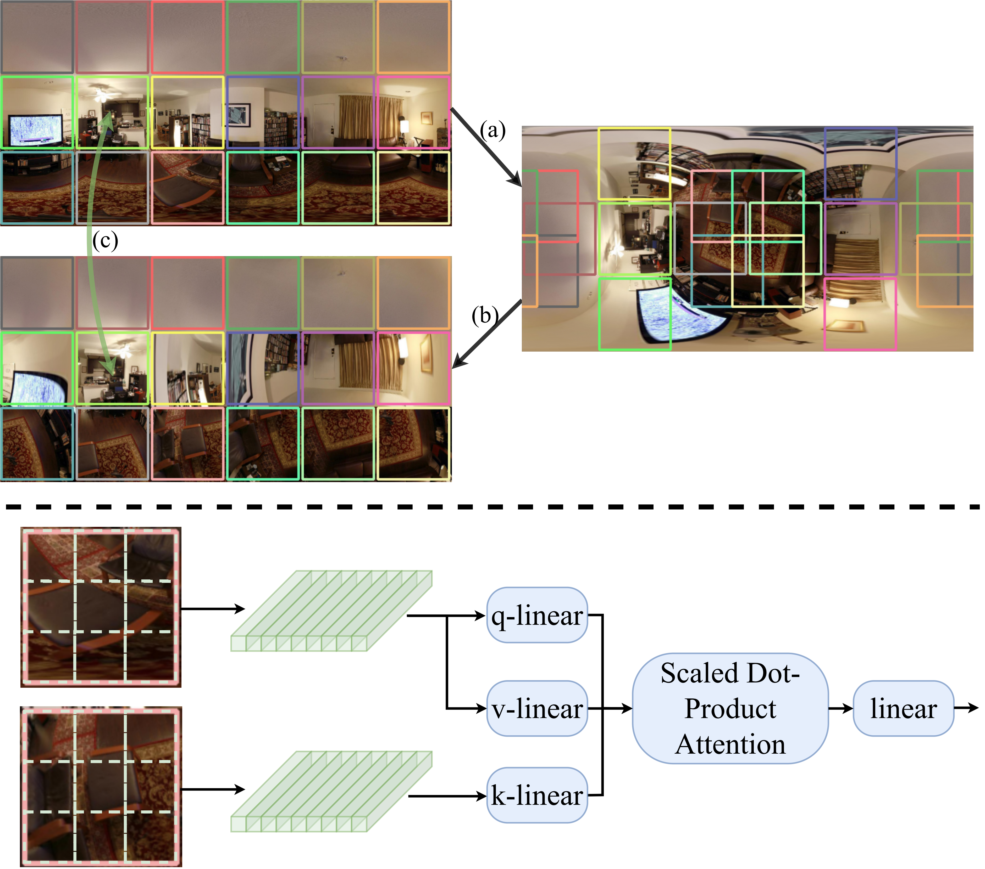
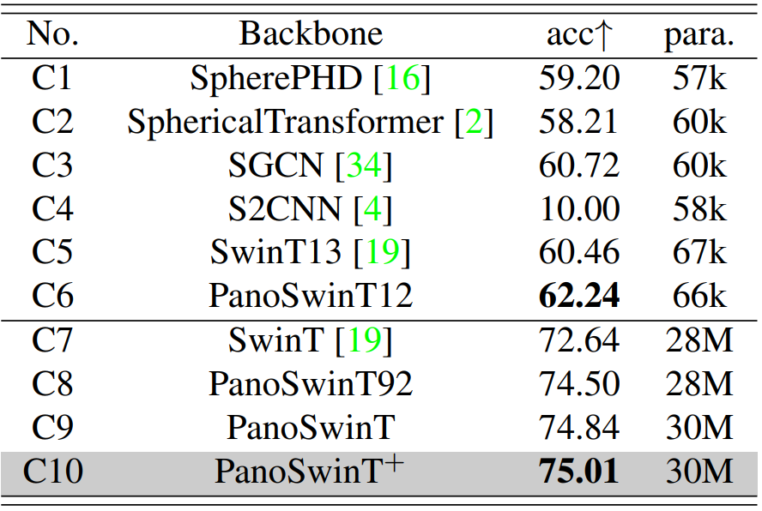
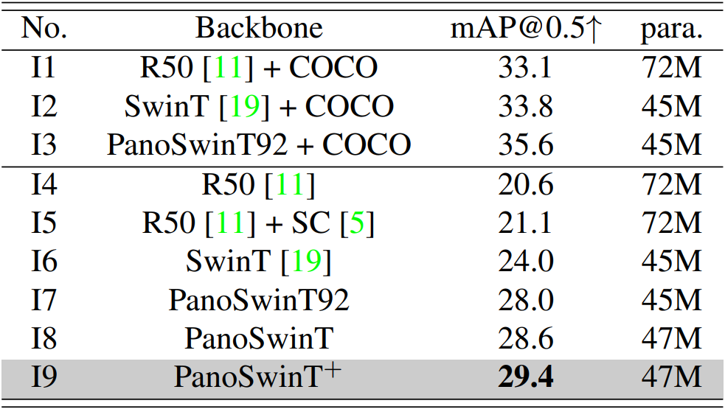
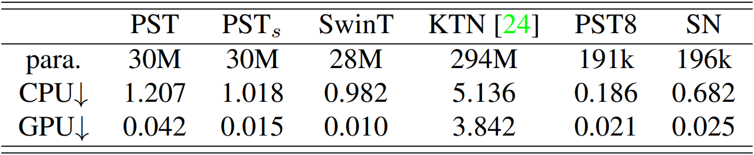
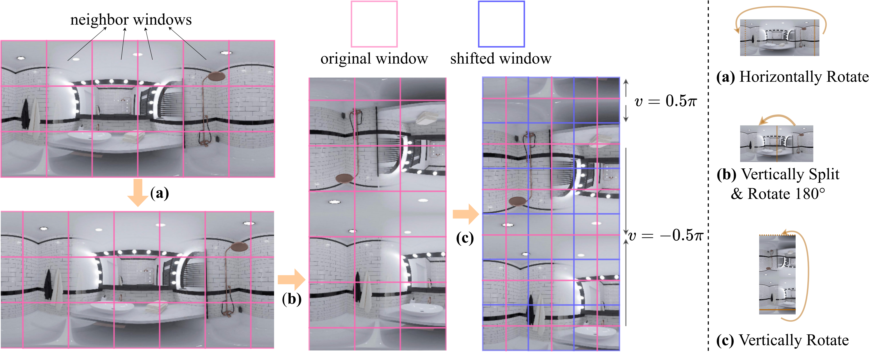
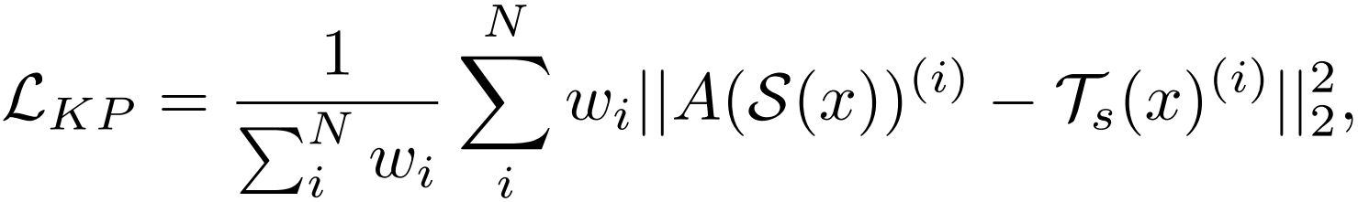
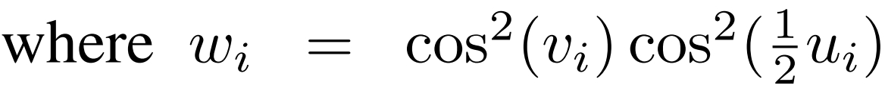
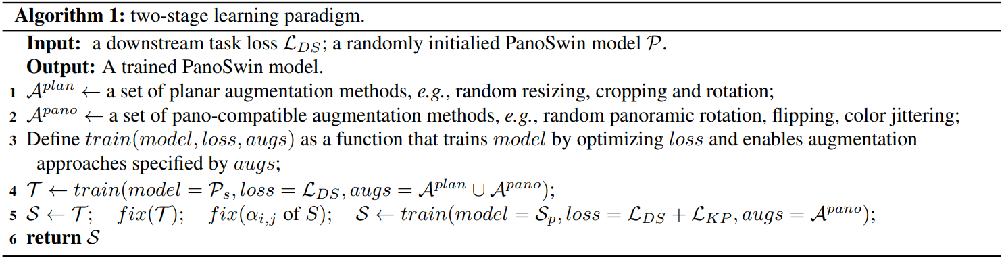
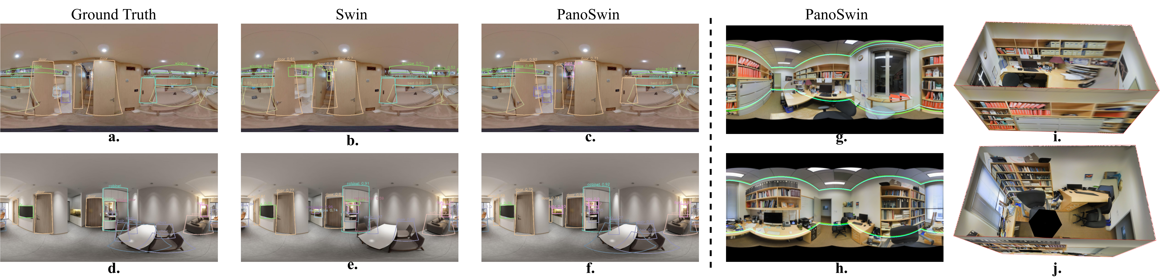
PanoSwin: A Pano-style Swin Transformer for Panorama Understanding
Zhixin Ling Zhen Xing Xiangdong Zhou Manliang Cao Guichun Zhou
School of Computer Science, Fudan University
{20212010005, zxing20, xdzhou, 17110240029, 19110240014}@fudan.edu.cn
Introduction:
A panorama presented by equirectangular projection(ERP) is just like a common planar world map. Regular CNNs or ViTs cannot learn panorama representation well due to two fundamental problems:
Polar and side boundary discontinuity.
Spatial distortion.
Based on Swin Transformer, we propose PanoSwin to deal with with these two above problems. PanoSwin is featured with three contributions:
We propose a Pano-style Shift Windowing scheme (PSW) to resolve boundary discontinuity.
We propose a pitch attention module (PA) to overcome spatial distortion.
We propose a two-stage learning paradigm to transfer common knowledge from planar images to panoramas.
Method - Pano-Style Shift Windowing:
Pano-style Shift Windowing scheme (PSW) consists of three steps:
Horizontally shift the image to enable the left/right side continuity.
Split the image in half and rotate the right half by 180° counterclockwise to enable the north pole continuity.
Vertically shift the image to enable the south pole continuity.
Method - Pitch Attention:
Pitch Attention(PA) also consists of three steps::
Rotate the pitch of the panorama by 90°.
Sample a new window in the rotated panorama for each original window.
Perform window attention between original and new windows.
Method - Two-stage Learning Paradigm:
PanoSwin is divised to be compatible with planar images, so common knowledge can be easily transferred from planar images to panoramas via a two-stage learning paradigm and a KP loss.
Results:
Quantitative results on panoramic classification (the left table) and panoramic object detection (the right table) show the effectiveness of PanoSwin.
PanoSwin only manipulates the panorama in the form of ERP, instead of tangent planes or local patches. Therefore, PanoSwin (PST) is fast as Swin and better than other panoramic backbones, as shown in inference time comparison.
Qualitative results on panoramic object detection and panoramic layout estimation imply that PanoSwin can deal with boundary discontinuity and spatial distortion.

